Slide 1
ARP
- Puneet Kumar

Slide 2
Address Resolution Protocol (ARP)
It is a network protocol used to determine the MAC address (hardware address) from any IP address.
In other words, ARP is used to mapping the IP Address into MAC Address.
When one device wants to communicate with another device in a LAN (local area network) network, the ARP protocol is used.

Slide 3
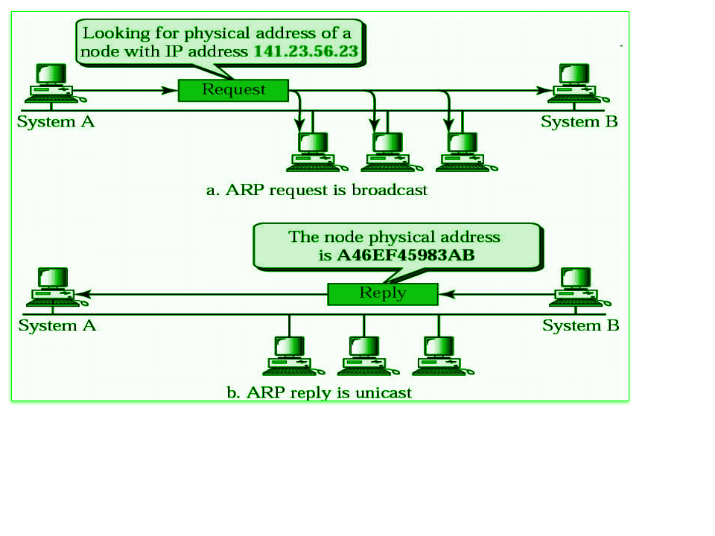
How ARP Works?

Slide 4
Working of Address Resolution Protocol
When a sender wants to communicate with a receiver, the sender first checks its ARP cache. Sender checks whether the receiver's MAC address is already present in the ARP cache or not?
If the receiver's MAC address is already present in the ARP cache, the sender will communicate with the receiver using that MAC address.
If the MAC address of the receiver device is not already present in the ARP cache, then in such a situation an ARP request message is prepared by the sender device. This message contains the MAC address of the sender, IP address of the sender and IP address of the receiver. The field containing the MAC address of the receiver is left blank because it is being searched.

Slide 5
Working of Address Resolution Protocol
Sender device broadcasts this ARP request message in the LAN. Because this is a broadcast message, every device connected to the LAN receives this message.
All devices match the receiver IP address of this request message with their own IP address. Devices whose IP address does not match drop this request message.
The device whose IP address matches the receiver IP address of this request message receives this message and prepares an ARP reply message. This is a unicast message which is sent only to the sender.

Slide 6
Working of Address Resolution Protocol
In ARP reply message, the sender's IP address and MAC address are used to send the reply message. Besides, in this message the receiver also sends its IP address and MAC address.
As soon as the sender device receives this ARP reply message, it updates its ARP cache with the new information (Receiver's MAC address). Now the MAC address of the receiver is present in the ARP cache of the sender. The sender can send and receive data without any problem.

Slide 7
Thank You!

